Slide 1
Assignment 2: EDA
By Sriyaank Vadlamani

Slide 2


The Goal of this assignment is to Find interesting plots and statistics we can use to predict the price of a new York Airbnb.

Slide 3

Interesting plots

Slide 4

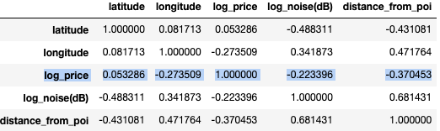
#1 Numerical Values don’t seem to have strong correlation
After looking at histograms of numerical values, and performing log operations on variables with right skewed histograms, we got the following correlation of 5 seemingly useable values
latitude: The latitude of the room
longitude: The longitude of the room
log_price: The log of the price of the room (what we’re trying to predict)
log_noise(dB): The log average sound levels of the room
distance_from_poi: The distance between the room and the nearest Point of Interest according to the nyc_locations dataset
All the variables correlate weakly with log_price, so not good variables to use, further shown by scatter plots on next slide

Slide 5
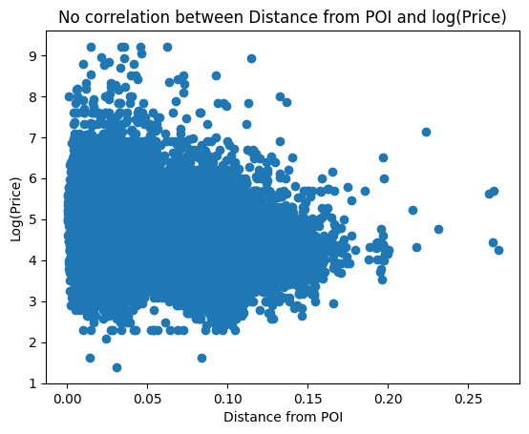
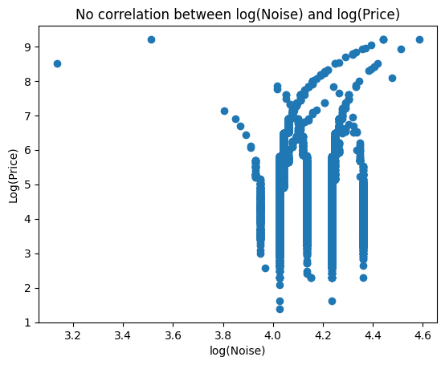
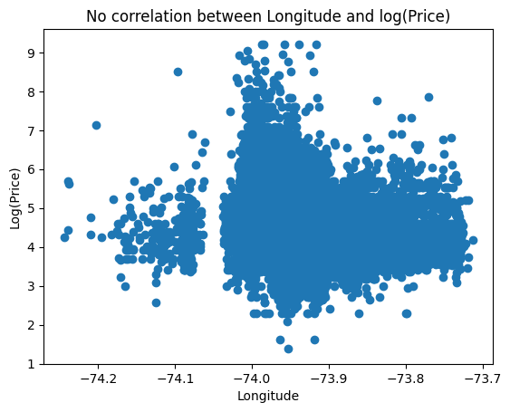
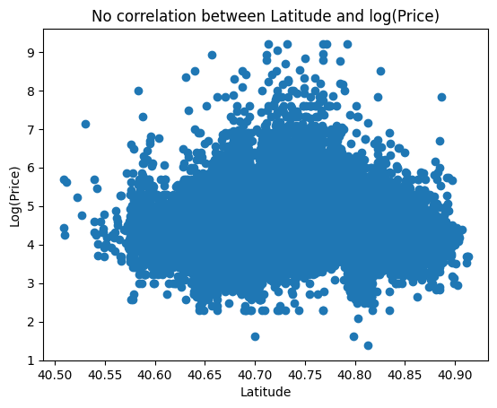

Slide 6
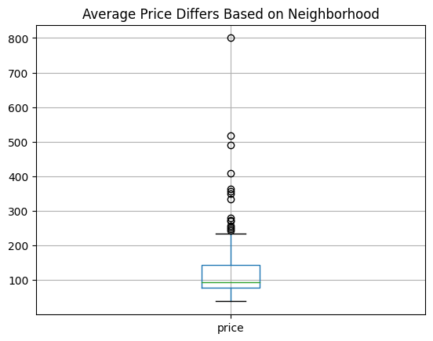
#2 Neighborhood affects Price
Box plot of list of Average Price for each neighborhood
Even if remove outliers, there is a very clear difference in average prices based on neighborhood
If there was no relation between neighborhood and price, the spread of the box plot wouldn’t be too large

Slide 7
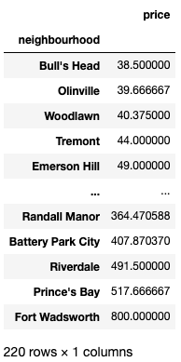
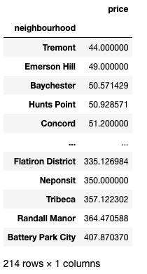
#2 Neighborhood affects Price (Continued)
For further analysis, we have the prices for each neighborhood sorted, both with outliers (top table) and without outliers (bottom table)
With outliers: Spread is $761.50, Bull’s head has the lowest average price ($38.50), Fort Wadsworth has the largest average price ($800)
Without outliers: Spread is $363.87, Tremont has the lowest average price ($44), Battery Park City has the largest average price ($407.87)
The spreads in average prices both with and without outliers are less than $50 lower than the largest average price, which is too big of a spread to say neighborhood doesn’t affect price

Slide 8
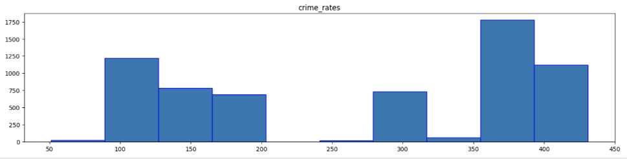
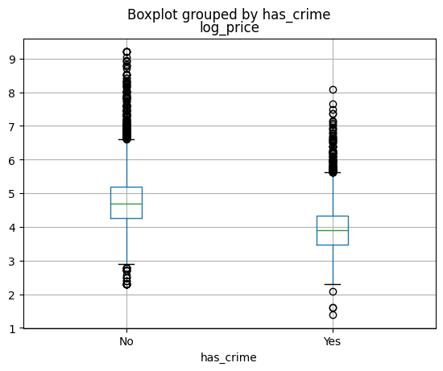
#3 The presence of crime affects price
When initially treating crime rates as a numerical variable (using the values from NYC_Crime_Statistics dataset), the histogram of the values did not show any patterns before or after log transformation, so I concluded I couldn’t use it for predicting price
Not every zip code had a recorded crime value
Turned crime rates into a categorical variable has_crime (has a recorded value for crime or doesn’t)
A box plot of has_crime appeared to have a large difference in log(price)
Very different statistics as shown in box plot
Decided to further test this through hypothesis testing

Slide 9
Hypothesis Testing

Slide 10

We conducted these tests on a randomly generated sample of the data frame, with only 10% of the rows of the original data frame
All the tests were done at the 5% level ($α=0.05$)

Slide 11
Hypothesis #1: Presence of Crime
As discussed, we will test if the presence of crime affects the price

Slide 12

Set-up
Let $μ_{0}$= Mean log price for rooms in places with crime
Let $μ_{1}$= Mean log price for rooms in places without crime
$H_{0} :μ_{0}−μ_{1}=0$
$H_{1} :μ_{0}−μ_{1}≠0$
Number of rooms in places with crime = 631
Number of rooms in places without crime = 3278
Since both values are greater than 30, we can continue with the theoretical test (z-test)

Slide 13

Results
$Z=\text{−25.86954918202637}$
$P=\text{1.4664941226484083}\text{e}\text{−147}≈0$
At the 5% level, p < alpha so we reject the null hypothesis.
The data shows significant evidence that the Mean log price for rooms in places with crime differs from the Mean log price for rooms in places without crime.
We can say that having crime plays an impact on the log price

Slide 14
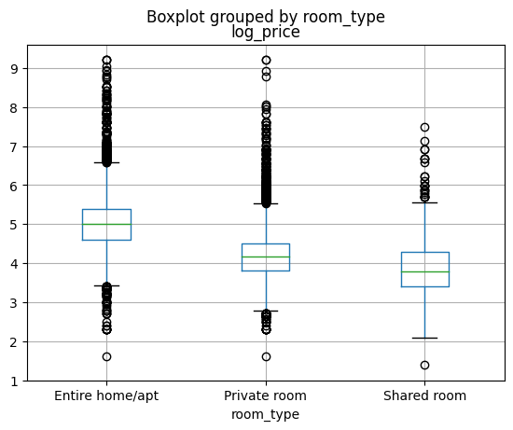
Hypothesis #2: Room Types
In the box plots for log price vs room type, it appeared as though the mean log price depended on the room type.

Slide 15

Set-up
Let $μ_{0}$= Mean log price for Entire home/apt room type
Let $μ_{1}$= Mean log price for Private room room type
$H_{0} :μ_{0}−μ_{1}=0$
$H_{1} :μ_{0}−μ_{1}≠0$
Number of for Entire home/apt rooms = 2023
Number of Private rooms = 1788
Since both values are greater than 30, we can continue with the theoretical test (z-test)

Slide 16

Results
$Z=\text{42.70697325252141}$
$P=0$
At the 5% level, p < alpha so we reject the null hypothesis.
The data shows significant evidence that the Mean log price for Entire home/apt room type differs from the Mean log price for Private room room type.
We can say that the room price plays an impact on the log price

